Slide 1
CAU task

Slide 2
min_pi_for_mean_match = 0.1,
Implementing new ideas
read_noise= 1.0 µS,
V | Min_pi | Train_MSE | Test_MSE | MSE_threshold | Samples | iterations | mode
0.4-1.5 | 0.2 | 1.59 | 1.55 | 0.2 | 1000 | 1000 | grey
0.4-1.5 |  |  |  |  |  |  | grey
0.4-1.5 | 0.2 | 1.24 | 1.22 | 0.2 | 1000 | 1000 | binary
0.4-1.5
0.4-0.7 | 0.2 | 0.91 | 0.89 | 0.2 | 1000 | 1000 | limited
MISTARI approach but for regression with
MSE threshold
But images look worse
But images look worse

Slide 3
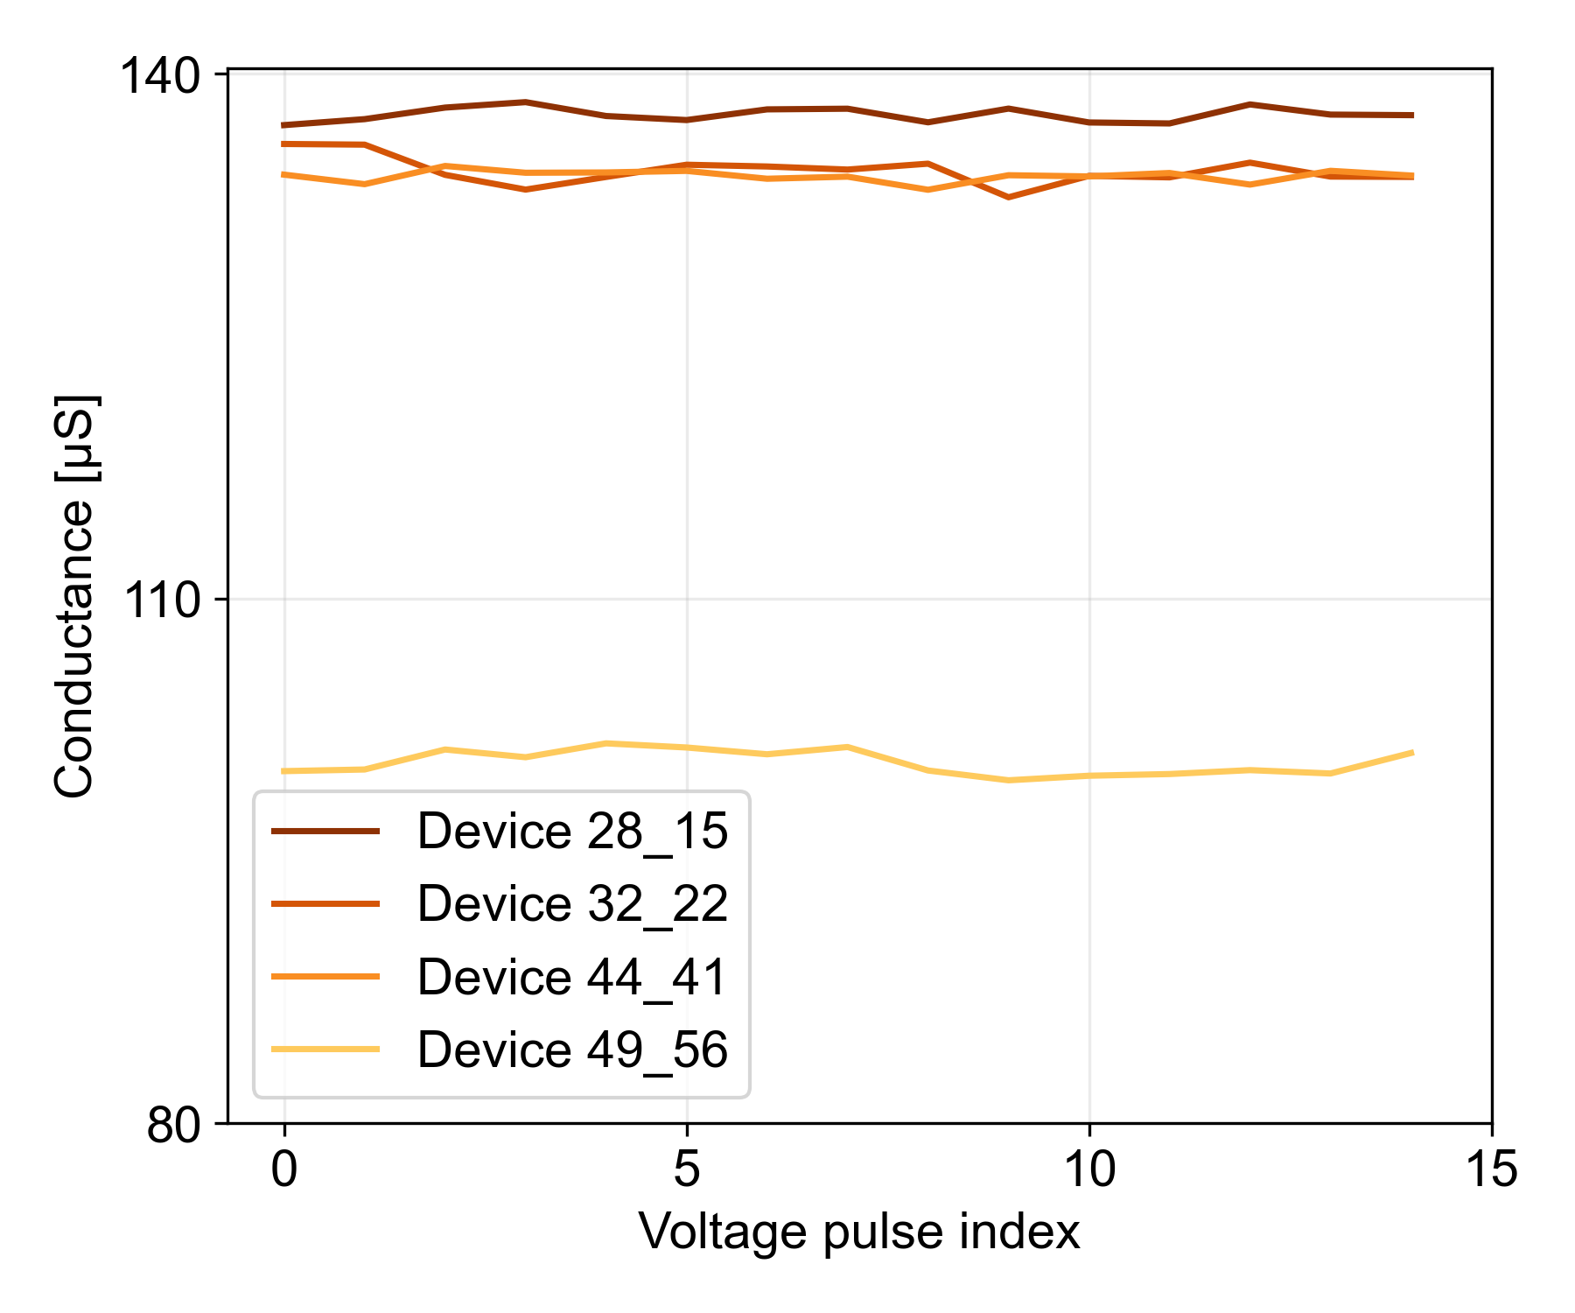
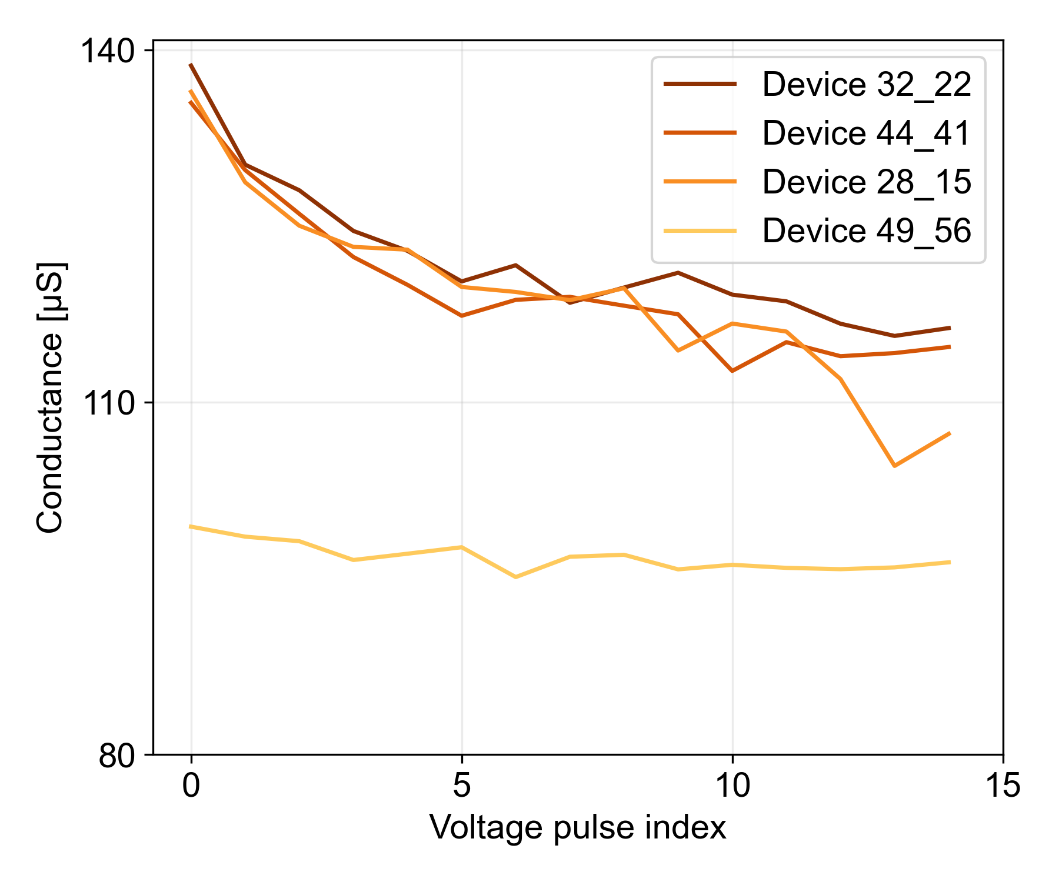
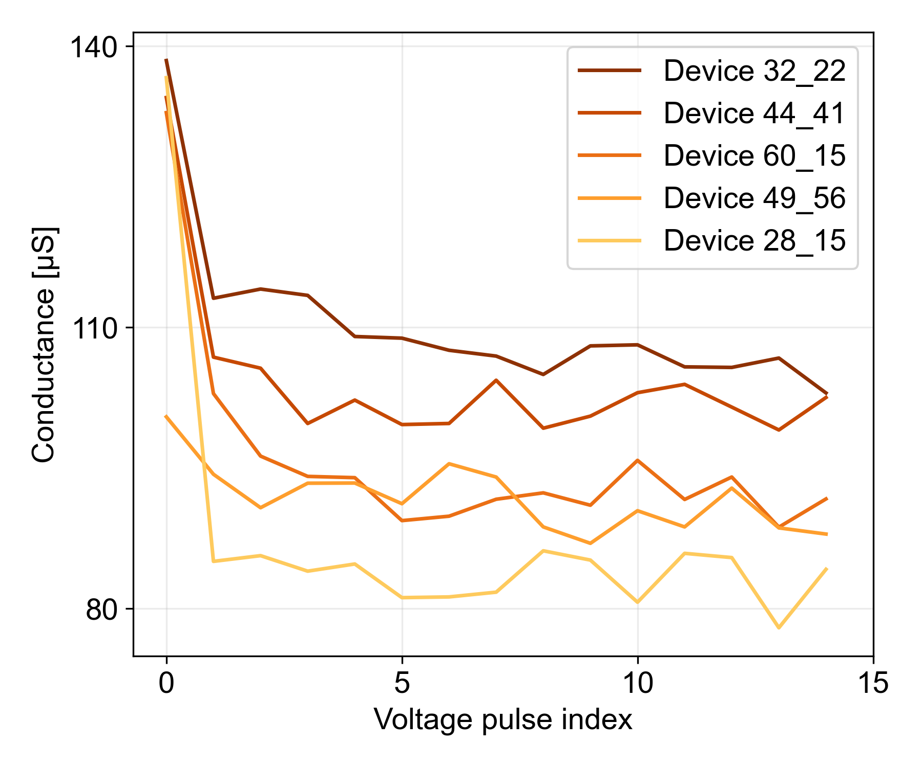
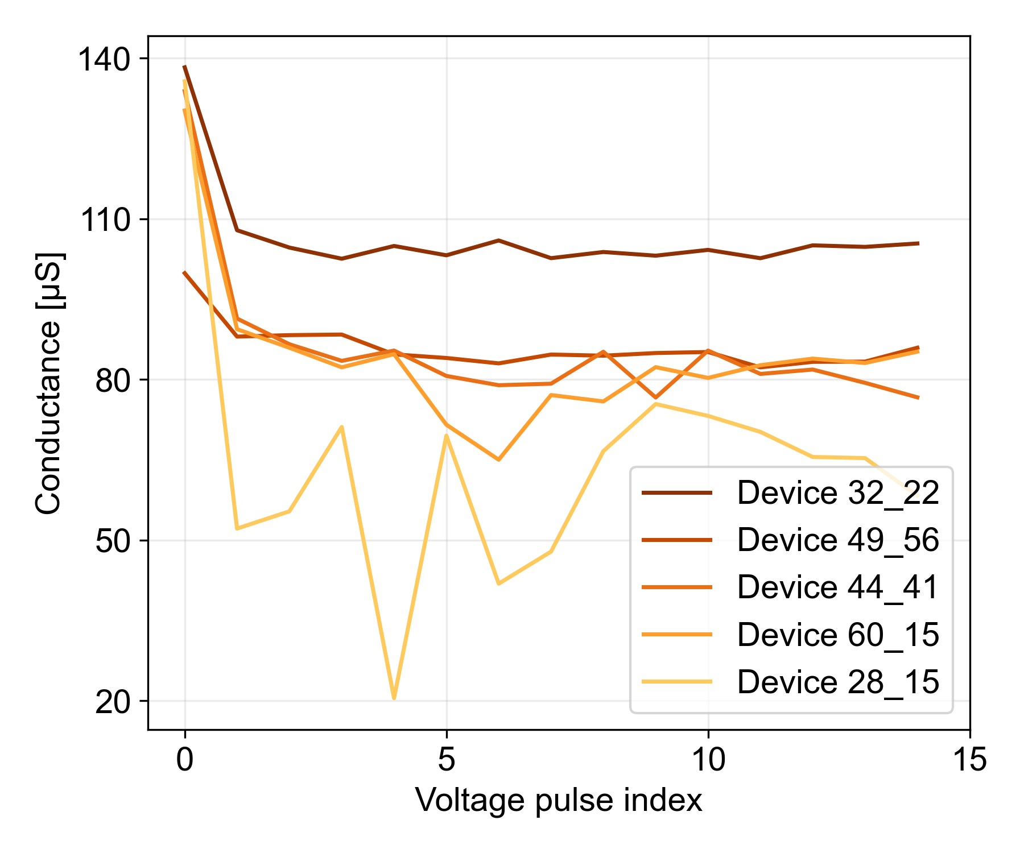
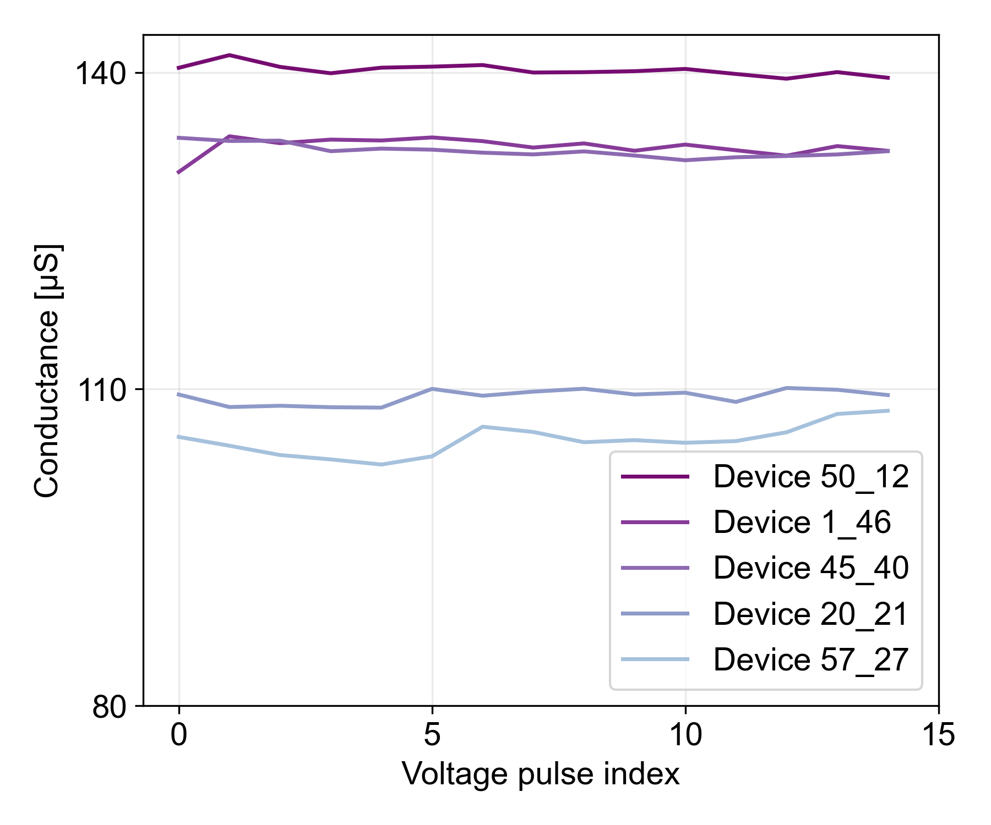
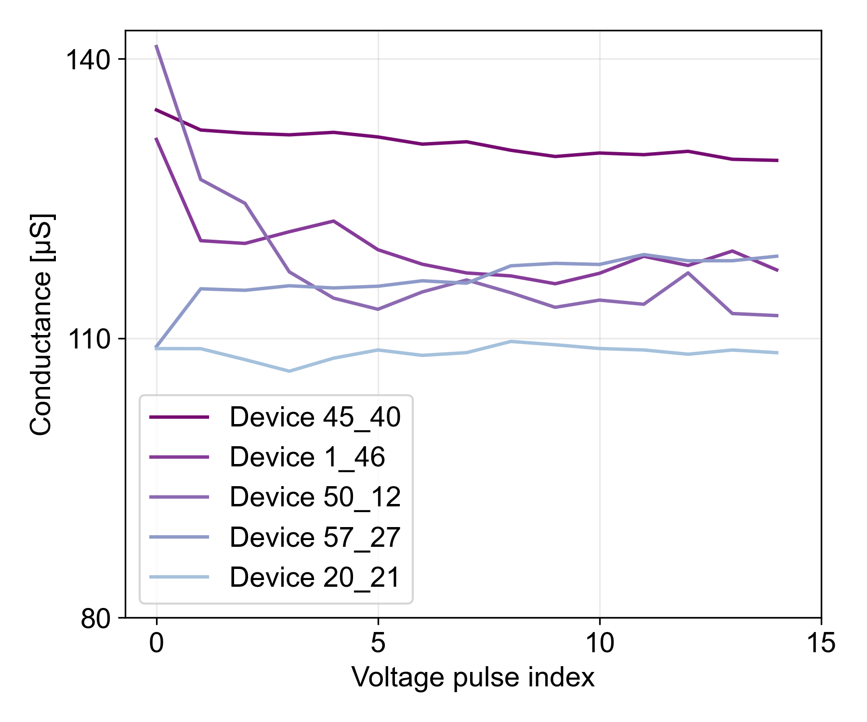
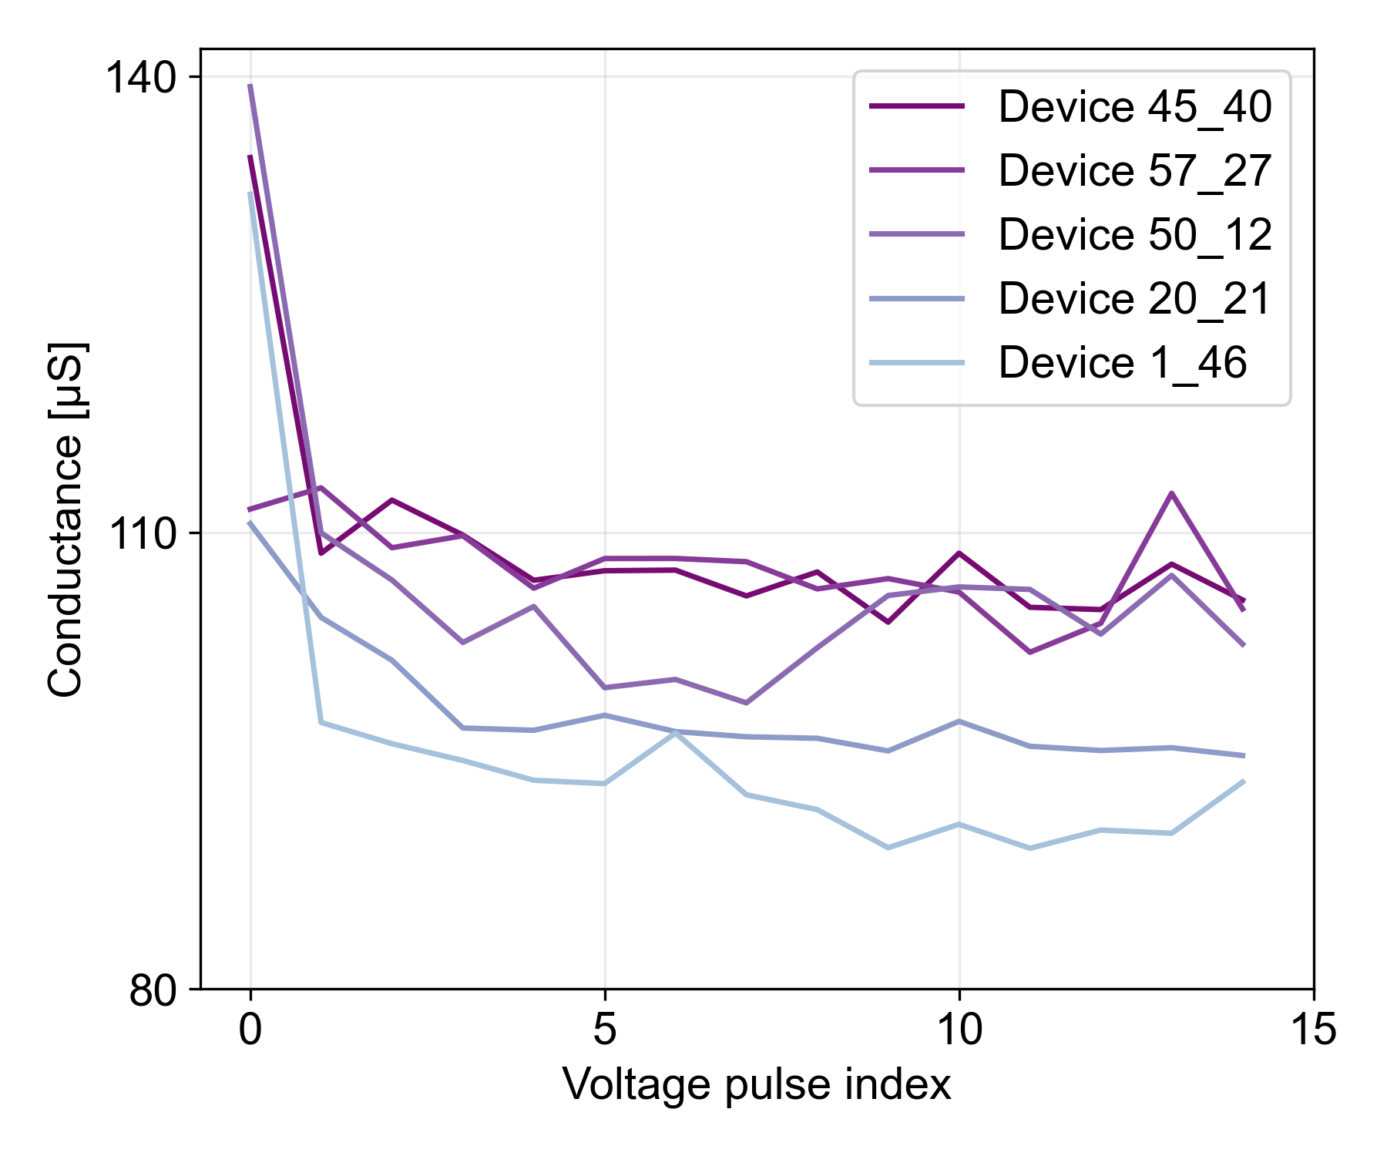
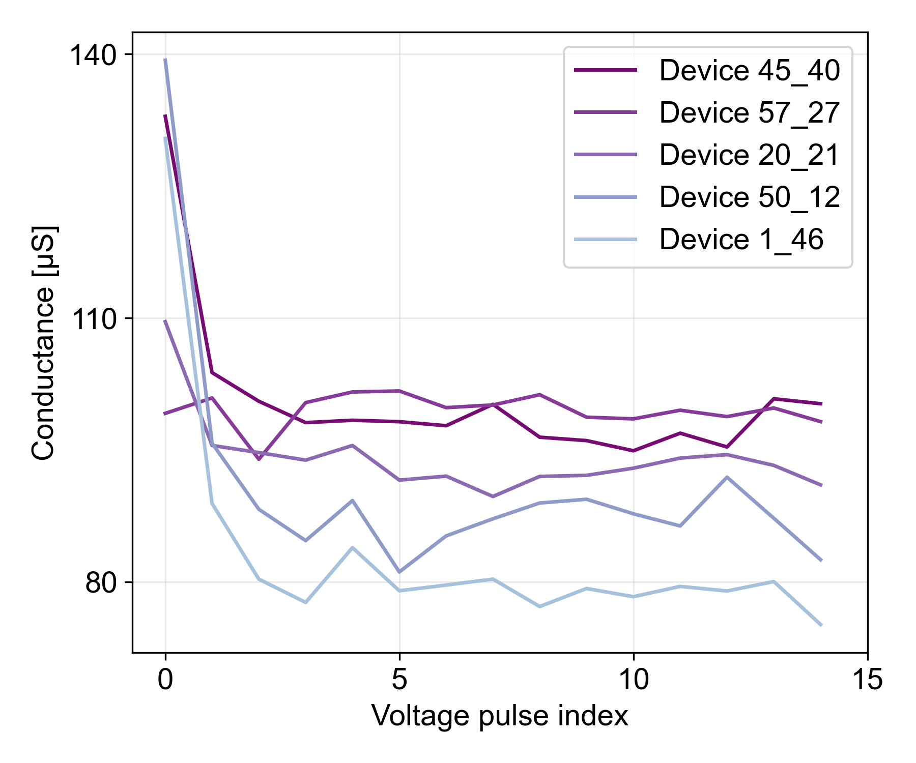
High On-Off ratio
0.4 V
0.5 V
0.6 V
0.7 V
Low On-Off ratio

Slide 4
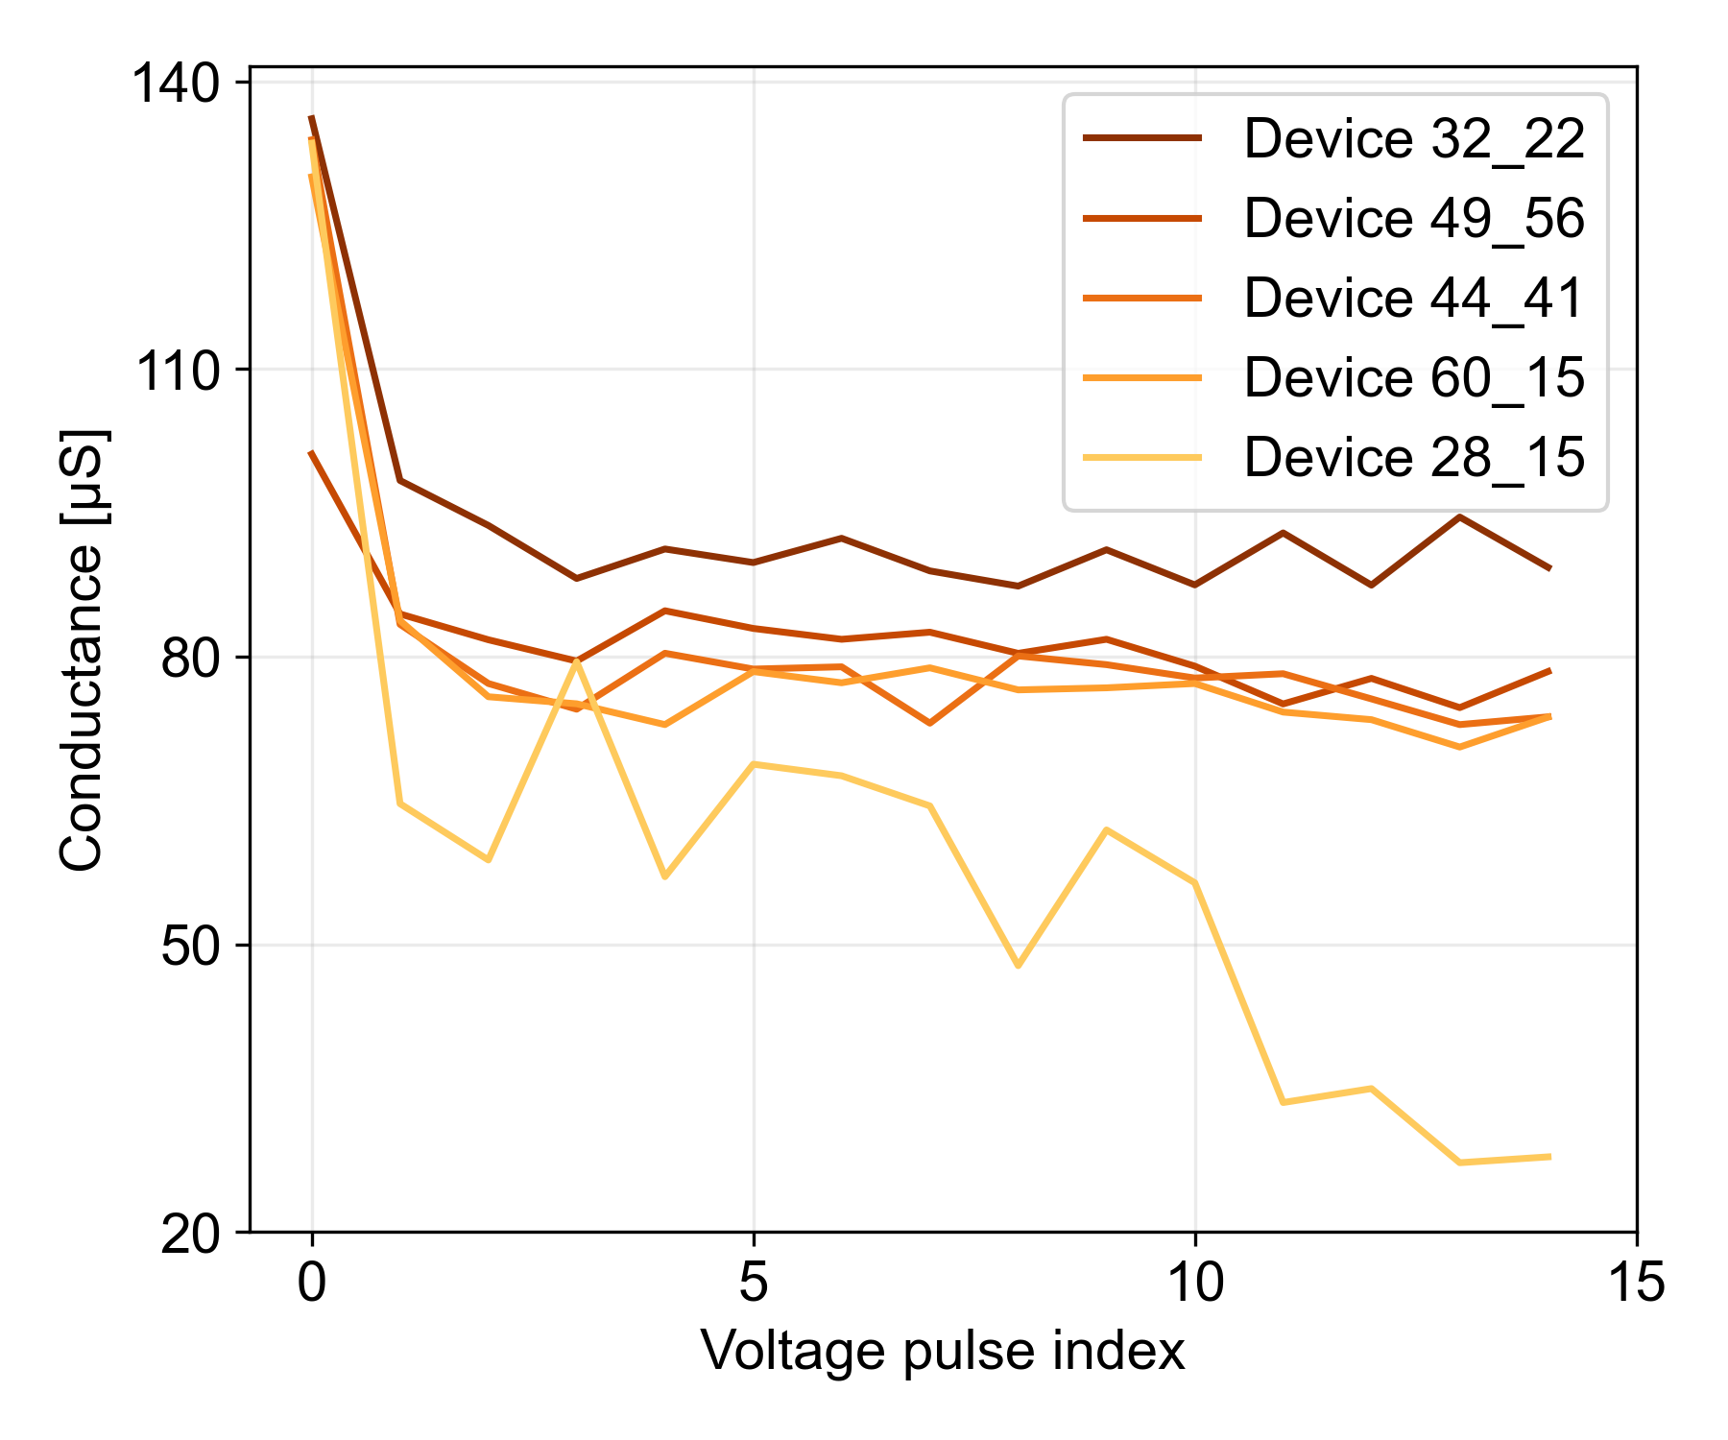
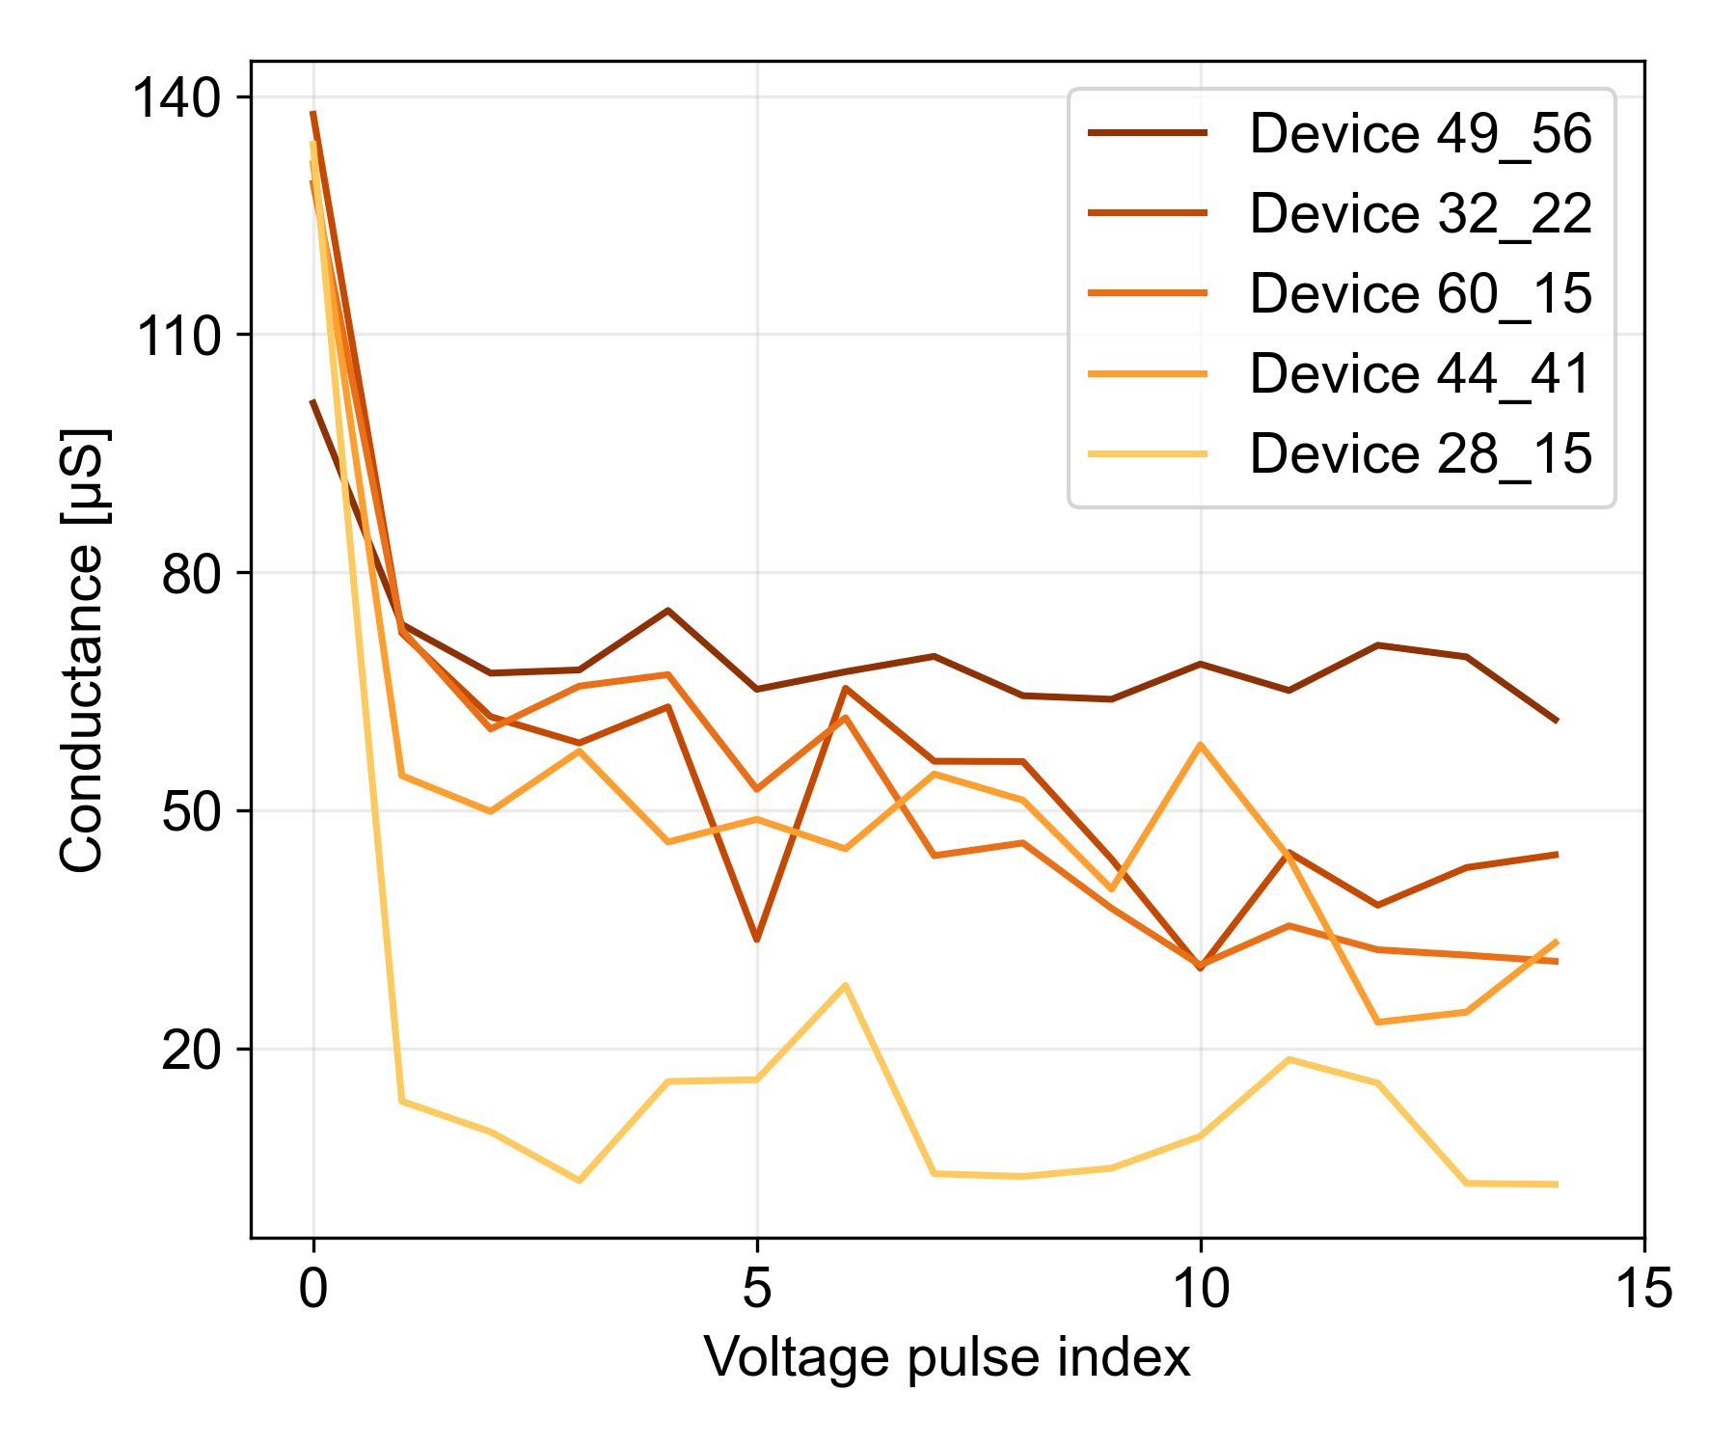
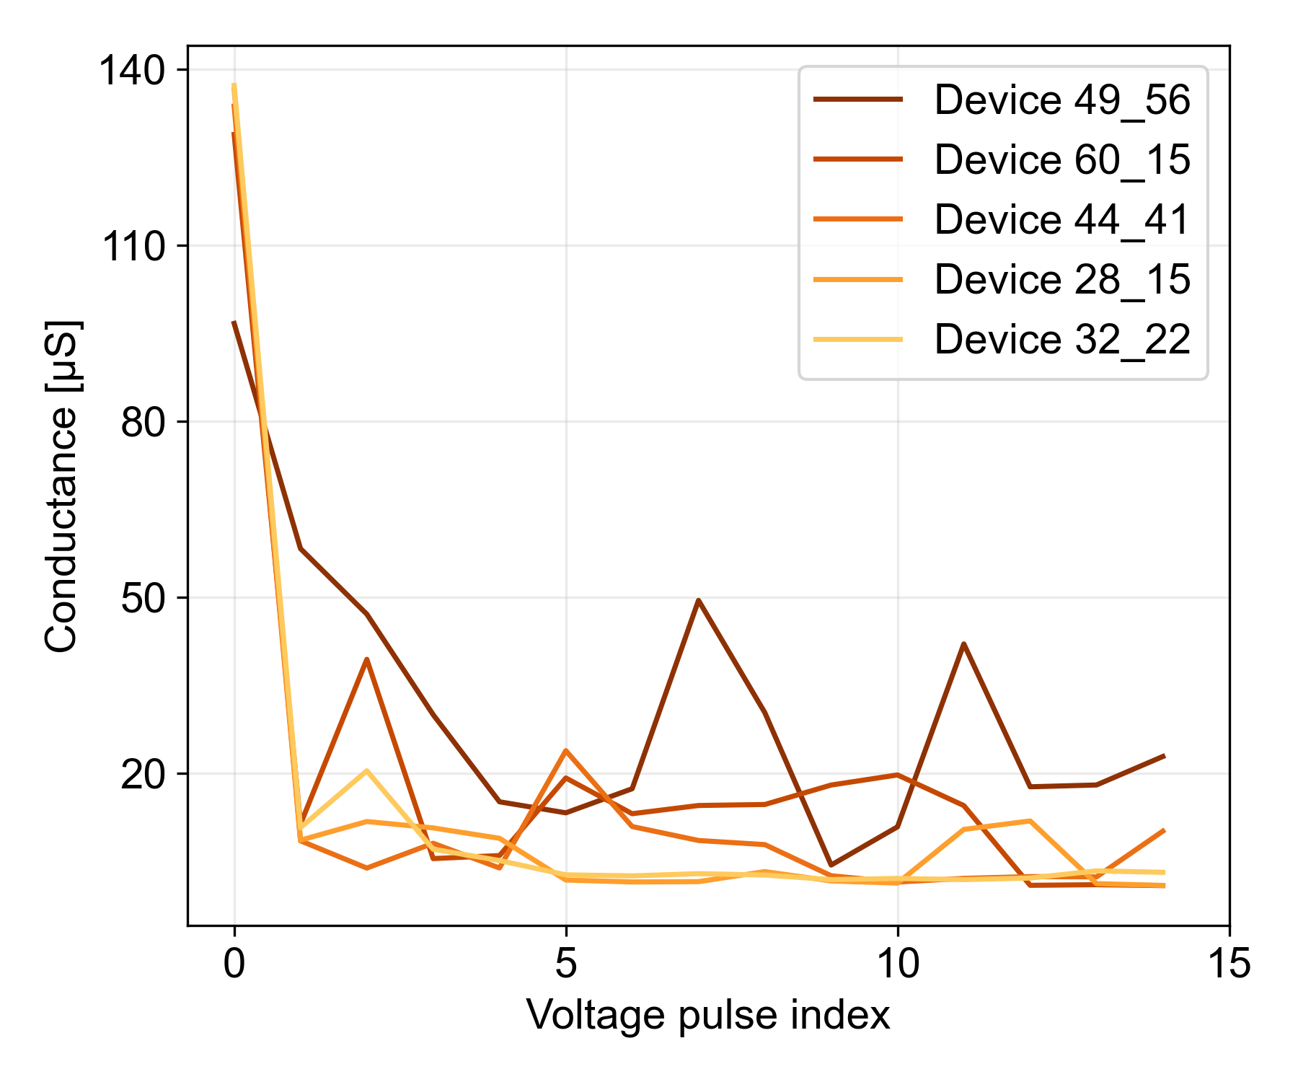
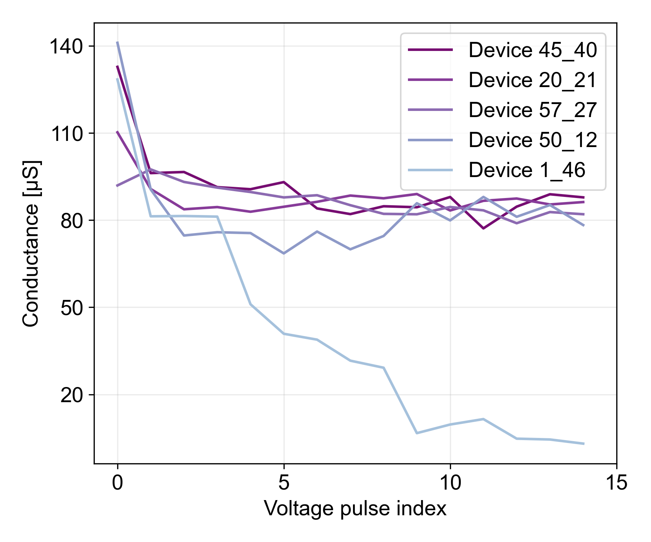
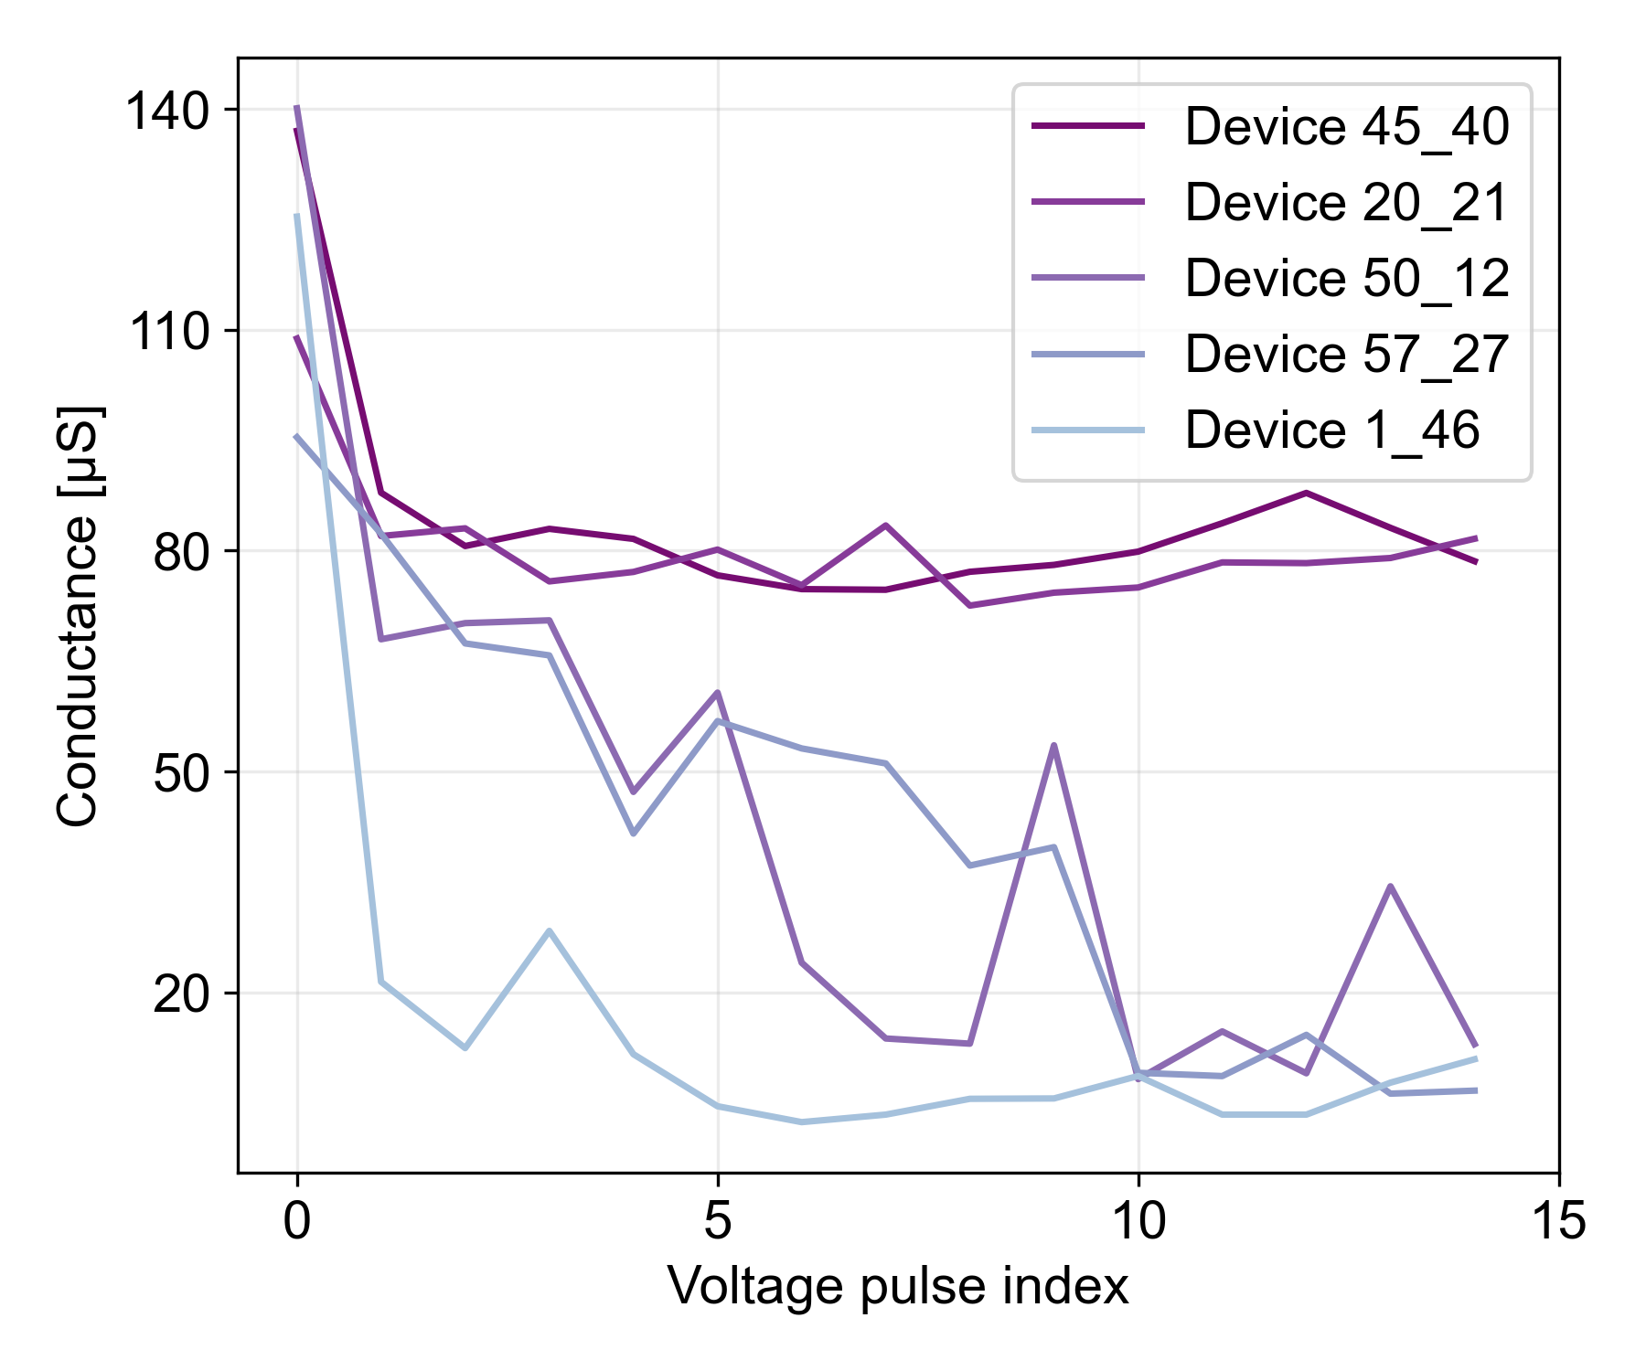
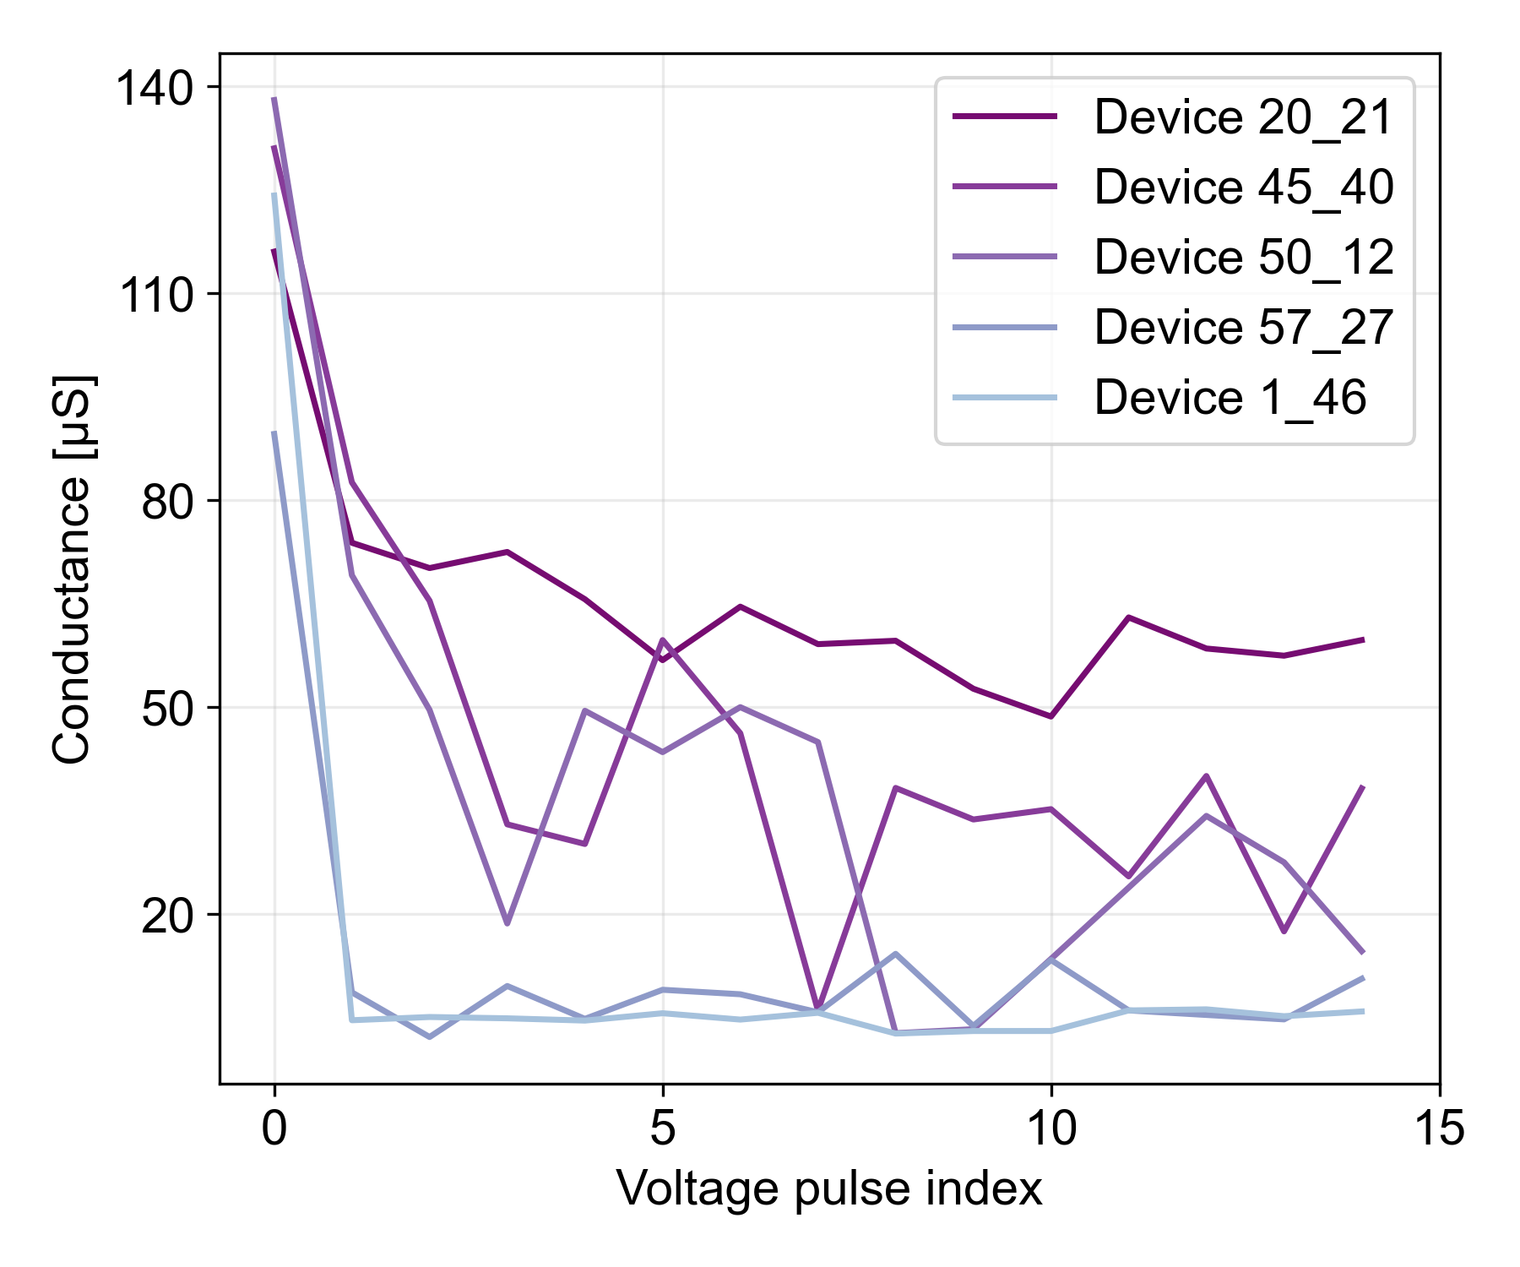
High On-Off ratio
0.8 V
0.9 V
1.0 V
Low On-Off ratio

Slide 5
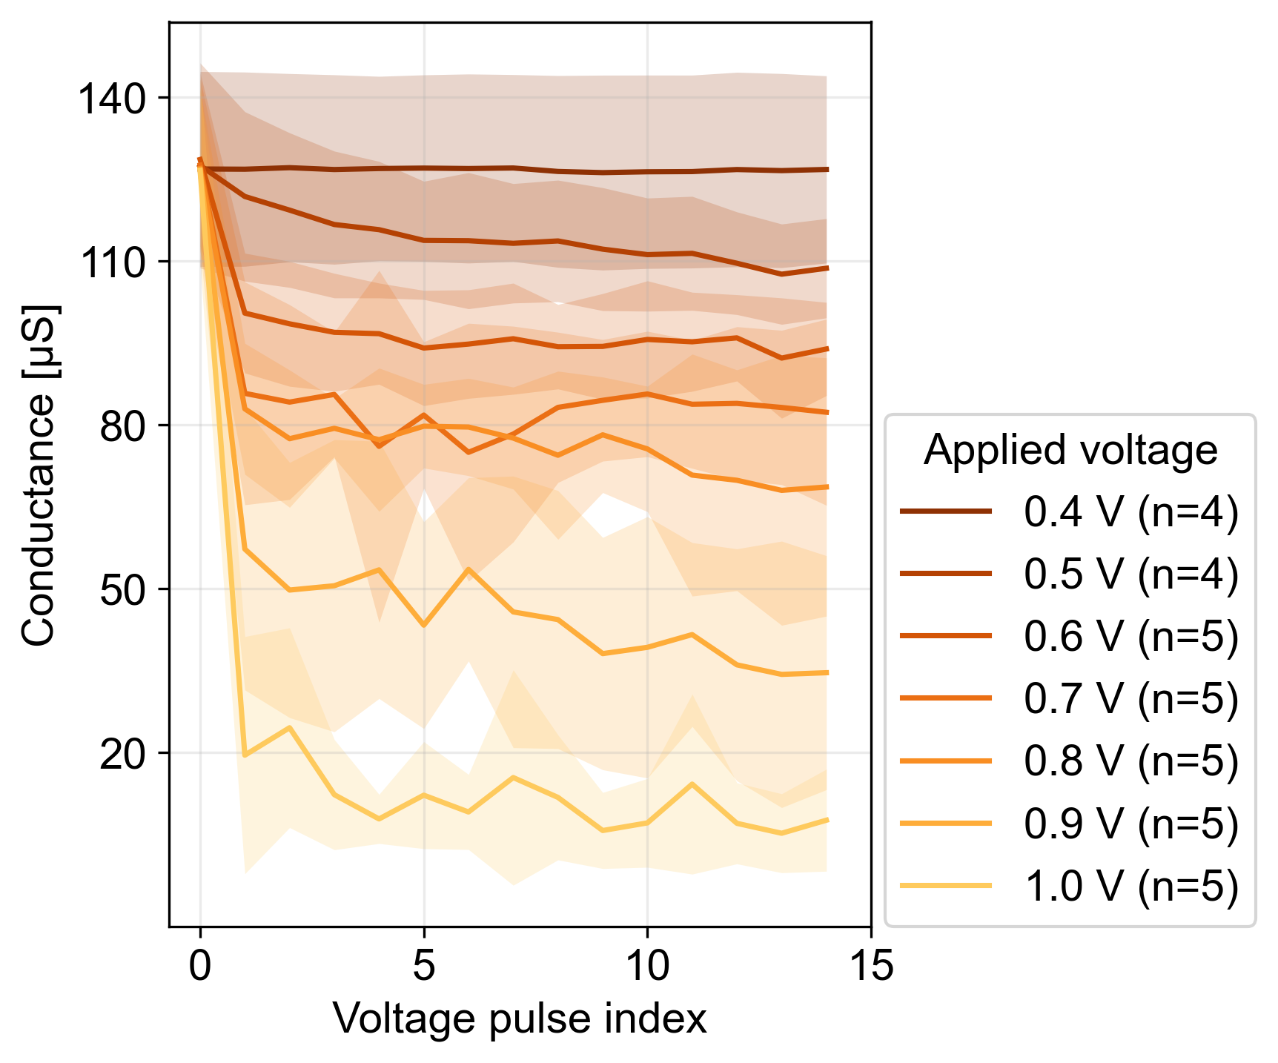
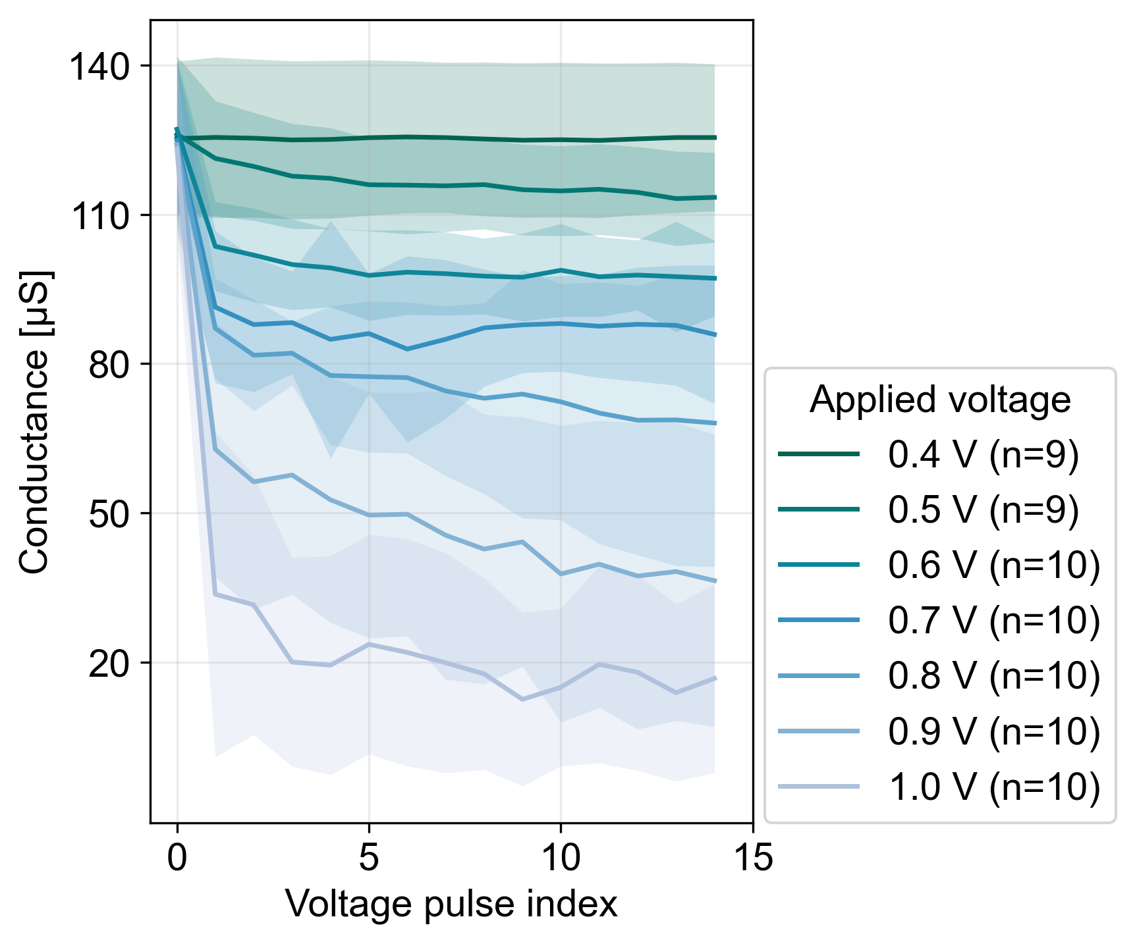
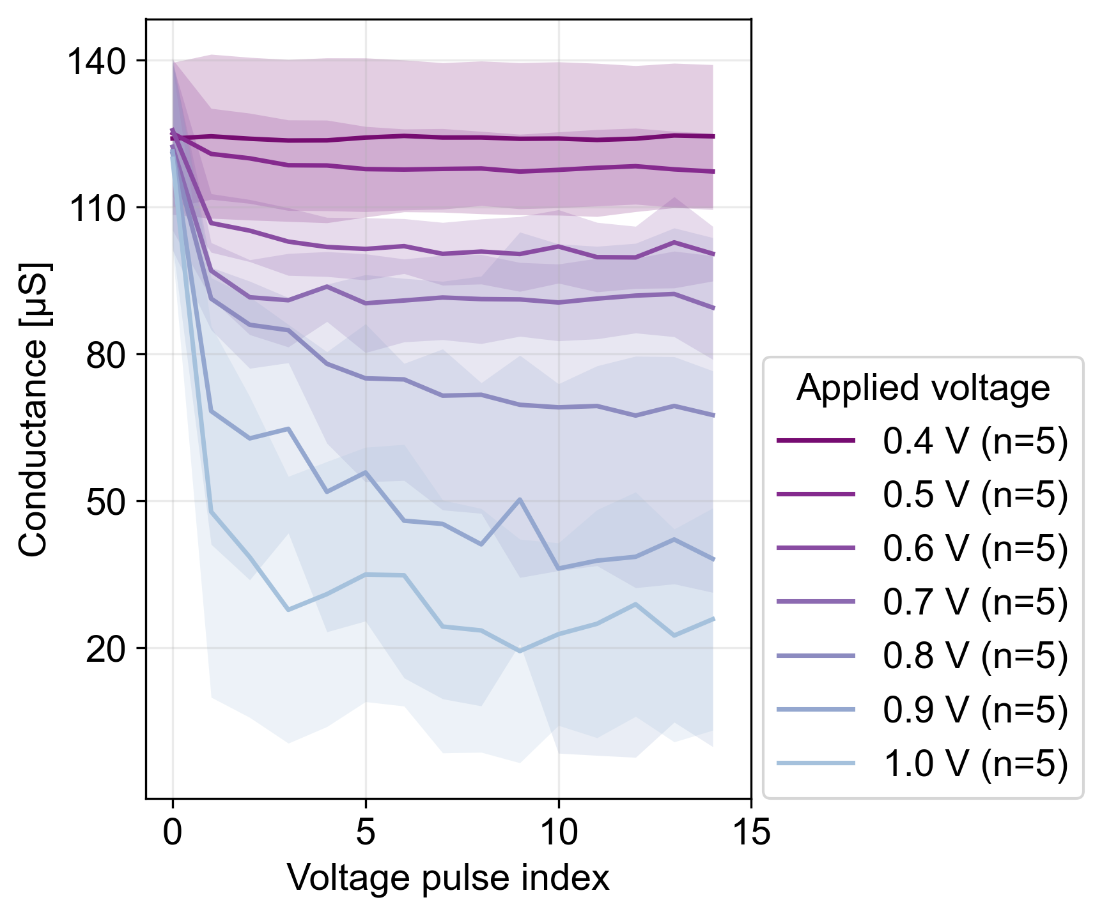
High On-Off ratio
Combined plot
Low On-Off ratio

